Slide 1

Report to the Citizens Blue Ribbon Committee on JPS Health Network Long Range Planning
Market Assessment – Financial Perspectives
May 23, 2017
Ray Jankowski, FHFMA, MBA, CPA (Inactive)
Managing Principal

Slide 2
Overall approach to financial perspectives
SWOT
Evaluate JPS Performance Profile and Trends
Benchmark and assess role within Tarrant County
Address external pressures and other factors
Delicate financial balance for public health systems

Slide 3
Evaluate JPS performance profile and trends
JPS Financial Performance
Breakdown of JPS Key Revenue Streams
Medicaid Supplemental Funding Streams
Year-over-Year Changes in Activity Levels

Slide 4
Jps financial performance
From FY2011 through FY2016*, JPS experienced:
A cumulative increase of 39% in Net Patient Service Revenues (NPSR), of which 23% occurred between FY2014 and FY2016
A cumulative 7.4% decrease in Net Patient Accounts Receivable, due mainly to significant improvements in revenue cycle performance (A/R collections)
Year-to-year fluctuations in Supplemental Medicaid funding
A cumulative increase in Property Tax Revenue receipts of 16.1%, with year-over-year increases being slightly higher in the two most recent fiscal years
A cumulative increase of 39% in salaries and related expenses, with the year-over-year increases being higher for FY2014-FY2016 than for previous years
* Based upon JPS audited financial statements for the above time period

Slide 5
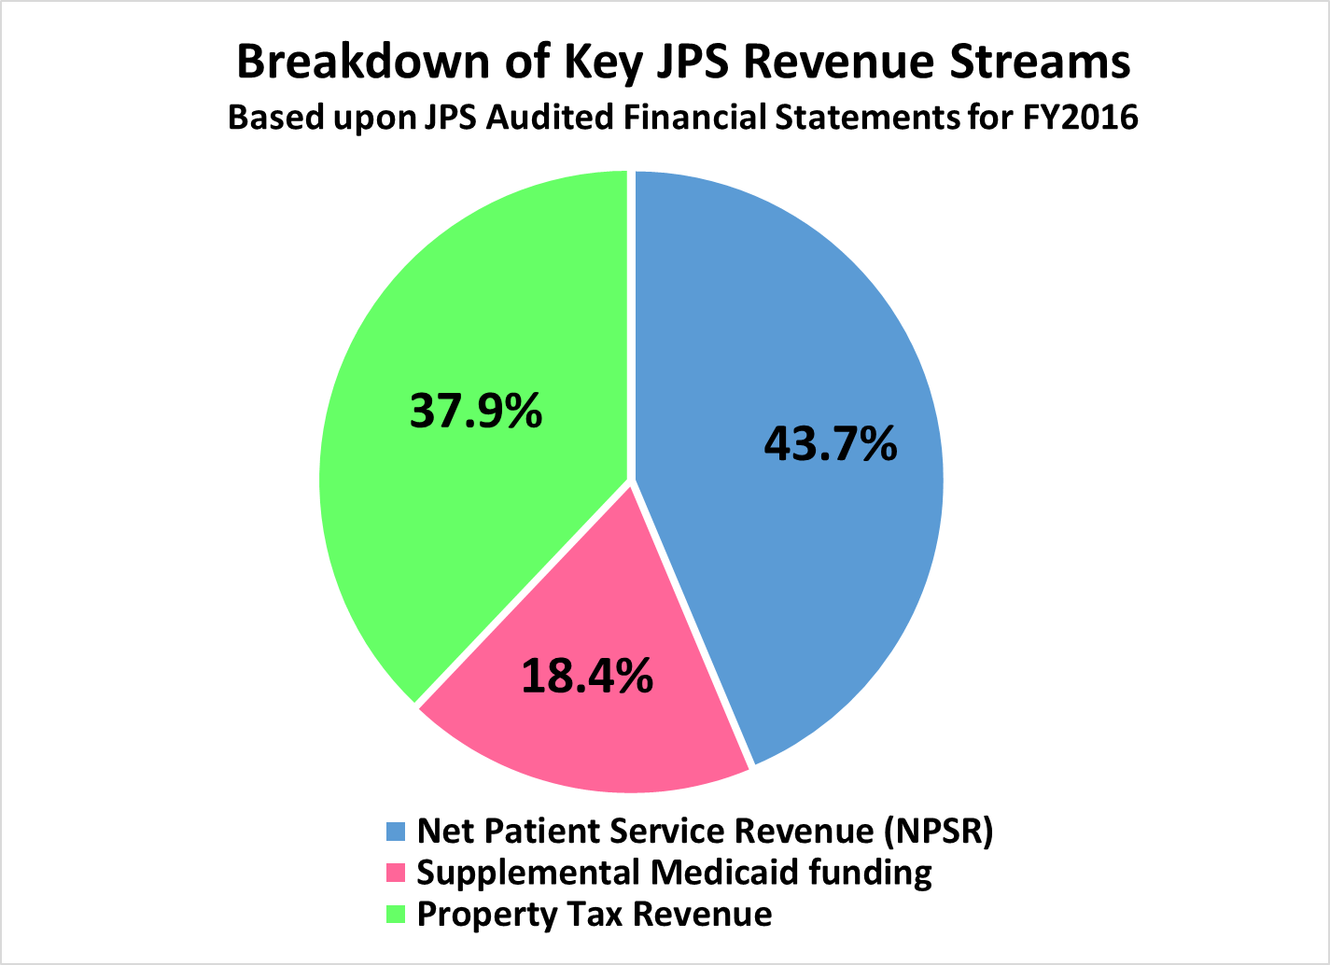
Breakdown of Jps key revenue streams
The above breakdown is fairly typical for public health systems

Slide 6
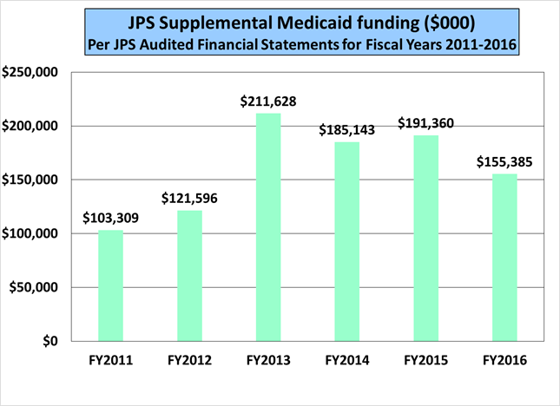
Medicaid supplemental funding streams
Medicaid supplemental funding includes Uncompensated Care (UC) funding, Delivery System Reform Incentive Payments (DSRIP), and Disproportionate Share Hospital (DSH) payments. Fluctuations in these funding streams is not uncommon.

Slide 7
Year-over-year changes in activity levels
From FY2013 to FY2016*, JPS experienced:
A modest increase in non-nursery, non-SNF patient days, comprised of a larger increase in Behavioral Health (BH) patient days and a very slight decline in acute non-BH patient days
A cumulative increase of nearly 15% in emergency visits, and a cumulative decrease of more than 4% in urgent care visits, the combination of which appears to be caused at least in part by constraints related to the layout and logistics of the existing facilities (see next slide)
Skilled nursing was recently outsourced to accommodate the growing need for medical/surgical inpatient beds
*Based upon JPS internal report entitled “Key Stats by Department”

Slide 8
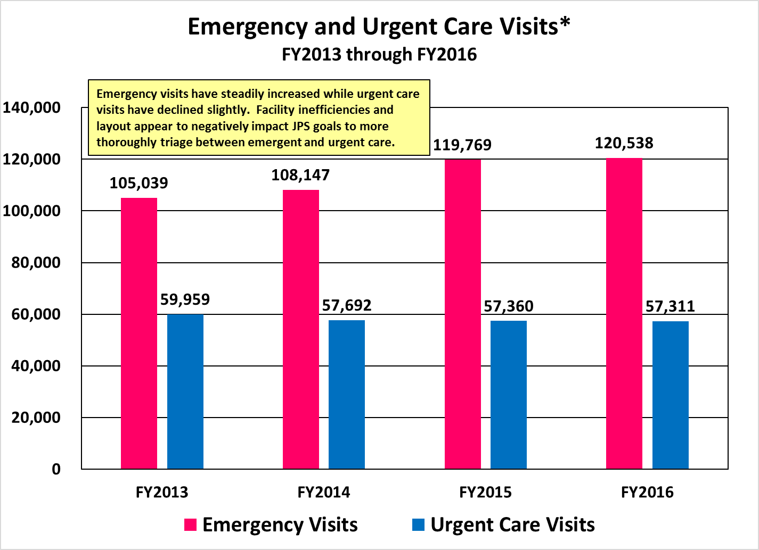
Year-over-year changes in activity levels (continued)

Slide 9
Benchmark and assess role within Tarrant county
Comparisons to other Texas public health systems
Service footprint of JPS in Tarrant County
JPS DSRIP Profile and Leadership
Unique role of JPS as a Trauma Center

Slide 10
Comparisons to other texas public health systems
Compared to other Texas Public Health Systems*, JPS has:
Significantly smaller financial losses from services to patients than the public health systems in Houston, Dallas, and San Antonio, but slightly higher losses than those of El Paso and Lubbock (see next slide)
Uncompensated care costs much lower than those of the public health systems in Houston and Dallas, and slightly above those of San Antonio and El Paso
Operating expenses per adjusted patient day equal to the median (~$2,800) of the Top 8 Texas public health systems plus Brackenridge, despite inefficiencies caused by the existing facilities
High patient acuity/intensity levels as reflected by its case mix index (CMI) of 1.85, which is the third highest amongst Texas public hospital systems and higher than the CMIs reported by the public systems in Houston and Dallas
*Based upon most recent year’s data from the American Hospital Association (AHA) database

Slide 11
Public health systems will continue to be under pressure
JPS’ net loss from service to patients was significantly less than that of three other large public health systems in Texas, based upon self-reported data in the American Hospital Association (AHA) database for the most recently reported year.

Slide 12
service footprint of Jps in Tarrant county
JPS has either the highest or second highest activity ranking for 16 of 18 service and age categories as mentioned below, where a ranking of “1” means highest activity level, “2” means second highest, etc.
Age Grouping | ED Inpatient Admits |  | ED Outpatient Visits |  | Non-ED Outpatient Visits
 | Total | BH Only | Total | BH Only | Total | BH Only
18 and over | 2 | 1 | 2 | 1 | 1 | 1
Under 18 | 2 | 1 | 10 | 2 | 5 | 2
All ages | 2 | 1 | 2 | 1 | 1 | 1
Based upon a sample of self-reported hospital data obtained through the Dallas Fort Worth Hospital Council for the 12 months ending 6-30-2016, JPS had the following activity rankings for the total Emergency Department (ED) and non-ED activity, and Behavioral Health (BH) only service categories listed below. It should be noted that a number of the specialty hospitals did not report, but the larger, full-service hospitals in Tarrant County are included.

Slide 13
service footprint of Jps in Tarrant county (continued)
JPS is a mainstay provider in Tarrant County*
  For the fiscal year ending 9-30-2017, JPS provided combined emergency and urgent care visits exceeding 175,000.
  Based upon 12 months of hospital data reported to the Dallas Fort Worth Hospital Council, JPS provides a disproportionate share of both emergency department (ED) care and behavioral health (BH) services in Tarrant County:
    More than 110,000 ED outpatient visits for those age 18 and over, second only to Texas Health Resources (THR) Fort Worth
    More than 17,200 ED inpatient admissions for those age 18 and over, second only to THR Fort Worth
    More than 7,200 ED inpatient admissions for those under age 18, second only to Cook Children’s Hospital
    More than 1,200 BH ED inpatient admissions for those age 18 and over, more than any other facility in Tarrant County
  Per the AHA database, JPS provides more than three times the amount of total uncompensated care than any other Tarrant County hospital
* Based upon data from the Dallas Fort Worth Hospital Council database

Slide 14
JPS DSRIP and uncompensated care PROFILE and leadership
A critical leader and partner for DSRIP and UC in Tarrant County, JPS:
  Is the anchor for the RHP 10 Region DSRIP program and Regional Healthcare Partnership, covering 9 counties
  Has 27 active DSRIP projects that include improving access to care, integration of primary care and behavioral health, disease specific projects, and coordination with other regional providers
  Provides significant funding on behalf of its private Tarrant County partners, putting forth the non-federal share of Intergovernmental Transfers (IGTs) that draw down federal funding on behalf of many Tarrant County facilities
  Has received, from its own efforts, net DSRIP revenue as follows:
    Demonstration Year 2 - $53.5 million
    Demonstration Year 3 - $43.4 million
    Demonstration Year 4 - $47.4 million
    Demonstration Year 5 - $52.9 million

Slide 15
Unique role of jps as a trauma center
There are 17 Level I trauma centers in Texas – 4 in Dallas, 3 in Houston, 2 each in Austin and San Antonio, and 1 each in El Paso, Fort Worth, Galveston, Lubbock, Temple and Tyler
Given the distance between Fort Worth and Lubbock, it is not surprising that JPS provides trauma care to a number of residents in counties other than Tarrant County
In fact, more than 42% of trauma inpatient charges, 38% of trauma inpatient discharges, and 30% of trauma outpatient charges are incurred on behalf of patients who do not reside in Tarrant County
Five counties represent slightly more than half of inpatient trauma services provided to people that do not reside in Tarrant County: Johnson, Wise, Parker, Dallas and Hood

Slide 16
Address external pressures and other factors
External pressures
Texas 1115 Transformation Waiver
JPS Connection: A community resource

Slide 17
External pressures
The modification or replacement of the Affordable Care Act, impacting
  Medicaid Expansion
  Insurance Exchanges
Texas Comptroller’s January 2017 biennial revenue estimate of $104.9 billion for the 2018-2019 biennium is down 2.7% from the latest projection for 2016-2017, potentially impacting JPS Medicaid funding
Although the percentage of uninsured in Texas has declined from 24% to 17% between 2010 and 2015, Texas still has the highest uninsured rate in the nation, as well as one of the largest unauthorized immigrant populations not eligible for either Medicaid or Exchange coverage
Texas overall and Tarrant County in particular are expected to continue experiencing significant population growth compared to other states
Although Texas accounts for slightly less than 9% of the U.S. population, it accounts for roughly a quarter of U.S. hospital closures since 2010

Slide 18
Texas 1115 transformation waiver
In 2011, Texas developed and the federal government approved a 5-year 1115 Medicaid waiver to build system capacity and to support innovation
  Approved 6 months before the Supreme Court ruling that effectively made the Medicaid Expansion optional for states, but Federal Medicaid officials’ approval of the waiver was based on the assumption that Medicaid Expansion would be in all 50 states
  Texas’ 1115 waiver budget for the 5-year period (2012-2016) totaled $29 billion, of which $17 billion were federal funds gained by Texas over 5 years
  The Uncompensated Care (UC) and Delivery System Reform Incentive Payment (DSRIP) pools each made up close to 50% of the total in the later years of the waiver
  A portion of the UC funds pool may be at risk
  In 2016, the Centers for Medicare and Medicaid Services (CMS) granted Texas a 15-month extension of its waiver through December 31, 2017
  Subsequently, the Texas Health and Human Services Commission submitted a request to CMS for a 21-month extension of the 1115 waiver that would take funding through Sept. 30, 2019. The request is to continue level funding for both the DSRIP and UC pools consistent with the current 15-month extension mentioned above. This additional extension would allow time to adjust to changes in existing federal health care law and an additional Texas legislative session from January to May 2019.

Slide 19
JPS connection: a community resource
Based upon FY2016 internal data, JPS Connection is a significant payer category across the key service lines of business, accounting for:
  13.4% of acute inpatient services
  12.7% of psychiatric inpatient services
  14.4% of emergency services
  33.7% of non-ER outpatient services
  28.2% of clinic services
  12.6% of outpatient pharmacy
JPS Connection reflects JPS’ commitment to serving Tarrant County, and it conceivably could do more if funding were available through community partnerships, grants, or other revenue sources

Slide 20
The delicate financial balance for public health systems
Public health systems fill the care gaps
JPS percentages of Tarrant County payer mix
Serving the uninsured and underinsured
Public health systems need help in covering costs
Leveraging capabilities for population health

Slide 21
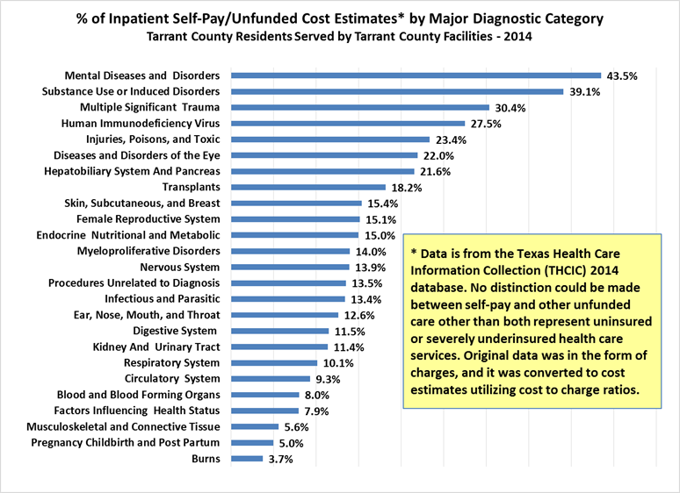
Public health systems fill the care gaps
Categories with high unfunded costs in Tarrant County are amongst the key service lines provided by JPS.

Slide 22
JPS percentages of Tarrant county payer categories
As the safety net for Tarrant County’s vulnerable populations, JPS serves high percentages of the inpatient Medicaid, inpatient uninsured, and outpatient insured services provided within Tarrant County.
Revenue Category | JPS Percentage of Tarrant County Total *
Inpatient - Insured | 13.7%
Inpatient – Medicare | 6.1%
Inpatient - Medicaid | 21.7%
Inpatient - Uninsured | 32.0%
Outpatient – Insured | 18.5%
Outpatient - Medicare | 8.9%
Outpatient - Medicaid | 8.6%
Outpatient - Uninsured | 39.8%
* Based upon DFW Hospital Council database, 12 months ending 9-30-2016

Slide 23
Serving the uninsured and underinsured
High percentages of JPS Inpatient, Mental Health, and Emergency Department services are rendered on behalf of uninsured or underinsured patients.
JPS Payer Mix Snapshot for Inpatient, Mental Health, & Emergency Dept. *
Payer Category | Inpatient | Mental Health | Emergency Dept.
Medicaid | 31.4% | 20.9% | 17.6%
JPS Connection | 13.4% | 12.7% | 14.4%
Self-Pay | 16.4% | 31.2% | 40.6%
Other Government | 4.5% | 13.3% | 2.4%
Total | 65.7% | 78.1% | 75.0%
* Source: JPS Health Network, Income Detail FY2013-FY2016

Slide 24
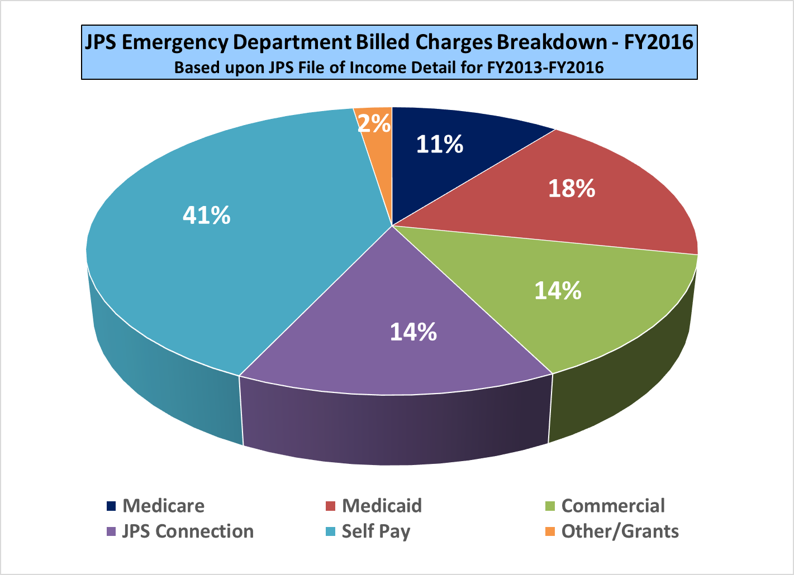
Like other public health systems, JPS emergency care disproportionately serves uninsured and underinsured

Slide 25
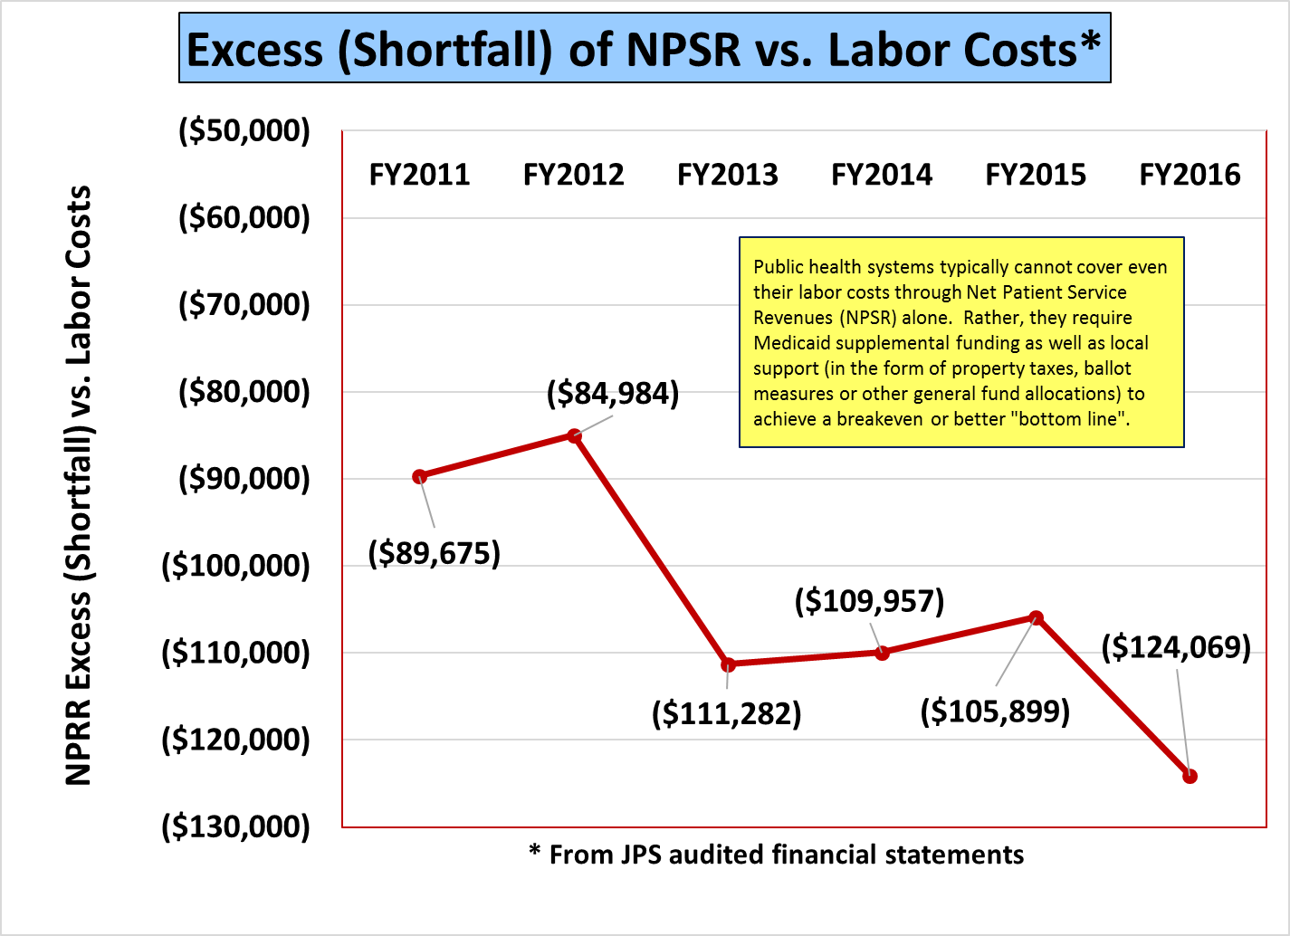
public health systems need help in covering costs

Slide 26
Leveraging capabilities for population health
JPS has a robust array of services, including emergency and trauma care, behavioral health, multiple clinic specialties, neonatal intensive care, and other tertiary and general acute care services
JPS may continue seeking potential partnerships that involve complementary adult and pediatric services in a managed care system
In addition to addressing facility needs, JPS could evaluate the feasibility of “elevating” the importance of ambulatory care within the context of its delivery system, including:
  Supporting expansion of the FQHC network
  Continue moving along continuum for Patient Centered Medical Homes (PCMHs) to position for value-based payment implementation

Slide 27
conclusions
High-level SWOT conclusions
Key observations
Recommendations

Slide 28
strengths
  From 2011 to 2016, JPS net patient service revenue (NPSR) increased by more than 39% while accounts receivable (A/R) declined by 7%, thus generating improved cash flow
  JPS ranks first or second in Tarrant County in ER inpatient admits, ER and non-ER adult outpatient visits, BH ER admits, BH ER outpatient visits, and BH non-ER outpatient visits
  JPS provides more than three times the amount of total uncompensated care as the Tarrant County hospital providing the second greatest amount of such care (per the AHA database)
  JPS has the third highest case mix index of all public hospitals in Texas, while having an overall readmission rate that is only slightly higher than the Tarrant County average
  JPS is the anchor for the 1115 Transformation Waiver RHP 10 and is actively engaged in the DSRIP program, not only as a participant, but also as an IGT funder for other providers in RHP 10

Slide 29
weaknesses
  For FY2016, JPS salaries and related expenses exceeded Net Patient Service Revenues (NPSR) by more than $124 million, a gap that unfortunately is fairly typical of public health systems
  Other than Neonatal Intensive Care and children’s wellness, JPS does not have a pediatric footprint, which weakens its Medicaid contracting ability
  JPS currently does not have operational productivity or cost accounting systems, although these are under development
  JPS has little experience with capitation or value-based purchasing
  The current layout of the hospital contributes to the existing inefficient use of human resources, which may restrict the extent to which salaries and related costs can be reduced
  The lack of private rooms and more efficient facilities impedes JPS’ ability to maximize revenues, improve operational efficiencies, enhance quality outcomes, maintain infection control, and ensure regulatory compliance

Slide 30
opportunities
  With sufficient resources and a more contemporary facility, JPS is poised to improve its market share of Medicare, exchange and private sector revenues
  JPS possesses the mission and infrastructure of services to more strongly embrace managed care, and it also has begun building strong relationships with Cook Children’s Health plan and other key providers and payers
  JPS will be implementing productivity and cost accounting systems
  There may be opportunities to better manage JPS’ employee medical plan for the benefit of its employees and to drive additional business to JPS
  Roughly 38% of JPS trauma discharges and 30% of outpatient trauma visits serve those who reside outside of Tarrant County, raising a question as to whether an additional funding opportunity is available from those counties or the state in recognition of JPS’ critical role as a regional trauma provider
  The State, with support from the Governor and Legislative leadership, has requested that CMS approve the existing structure of the 1115 waiver through September 2019

Slide 31
threats
  Non-replacement of the hospital could impair JPS’ ability to:
    Maximize reimbursement
    Improve patient satisfaction
    Enhance quality of care
    Meet regulatory requirements
    Improve operational efficiency
    Support training and education
  There is uncertainty related to the Texas 1115 Medicaid Waiver that could adversely impact JPS and other facilities that rely on Medicaid supplemental funding
  Within Tarrant County itself, JPS is one of the top two BH providers, serving an extremely wide geographic area, and threatening to be overwhelmed unless capacity is addressed
  There is uncertainty regarding the CMS approval of the Texas 1115 waiver renewal for Demonstration Years 7 – 10

Slide 32
Key Observations
JPS is the safety net leader in Tarrant County in terms of DSRIP and Uncompensated Care, working with Tarrant County Public Health and the private sector hospitals as appropriate within RHP 10
JPS is a significant and critical provider of Emergency and Behavioral Health Services within Tarrant County, particularly for those who are uninsured or underinsured
JPS is a critical provider of trauma care within and outside Tarrant County, and as the County’s population continues to grow in the coming years, JPS should lead discussions related to the potential need for a second Level I trauma center
The revenue and expense profiles of JPS, along with the challenges it faces, are fairly typical of public health systems
To a great extent, existing facilities are an impediment to the ability of JPS to operate more efficiently, to effectively transport patients and triage care, and to attract a broader payer mix of patients to help provide financial support to enable JPS to continue its mission of serving the uninsured and underinsured
JPS has demonstrated improvement in revenue cycle performance and begun the process of building cost accounting and productivity systems
There are opportunities to continue focusing on collaboration and addressing countywide issues such as transportation that would accrue to the benefit of all Tarrant County residents, which ultimately supports population health efforts

Slide 33
Financial recommendations
Encourage strategic and facility planning that focus on maximizing reimbursement and ensuring emergency and urgent care, community BH needs, and ambulatory care to support population health goals for the delivery of care in optimal settings
Facility designs should be efficiency-friendly as well as patient-friendly
Given the extent of trauma care being provided to residents of other counties, recommend asking those counties to provide some level of cost-based support for trauma care provided by JPS to their residents, and/or seeking State grants or other funding allocations to provide additional support for Level I trauma centers
Continue working with the State and participating DSRIP and Uncompensated Care partners to develop value-based models for preserving Medicaid supplemental funding to the extent allowed
Continue the discussions already begun with Cook Children’s Health Plan, Cook Children’s Hospital, and other significant providers of care to develop an MCO or ACO model to support greater opportunities for JPS in Medicaid managed care
Pursue continued discussions between Tarrant County, JPS, private sector hospitals, and potential transportation providers to develop near-term and long-range solutions that make it easier for residents to receive primary care, prenatal care, and outpatient behavioral health care services

Slide 34
Market assessment – financial perspectives
Question and Answer
Discussion

