Slide 1

Report to the Citizens Blue Ribbon Committee on JPS Health Network Long Range Planning
The Delivery System
April 18, 2017
Karen Batia, PhD, Principal
Greg Vachon, MD, MPH, Principal

Slide 2
Trends in U.S. HEALTH CARE
Culture of Health: health as a shared value; cross sector collaboration to improve well-being; healthier, more equitable communities
Health System Transformation: care integration; data analytics; telehealth; shifting from “sick care” to prevention and addressing social determinants of health
Whole Person Care: patient-centered coordination of medical, behavioral, and social services
Value Based Payment: move from fee-for-service to payments for outcomes
Medical Education and Provider Supply: adoption of new multidisciplinary training programs and reallocation of educational resources towards areas of need including primary care, behavioral health, and integrated practice models of care
Other important trends: personal responsibility in health behaviors, consumer choice, competition & consolidation, expensive medical advances (proteomics, biologics)

Slide 3
Delivery System as a Whole
Key points
    JPS is a critical provider in Tarrant County
    Capacity is strained and, for many services, clearly not adequate to meet current demand. Population growth will demand significant workforce enhancement.
    Prevention is foundational and needs strengthening
    (through population health, community connections, behavioral health supports and care management)

Slide 4
Delivery System as a Whole
High-level, big strengths
Trauma: only Level I, Emergency Medicine residency
Behavioral health, including Psychiatry residency
Nationally-recognized Family Medicine residency
Nurses Improving Care for Health system Elders (NICHE) designation
National Committee for Quality Assurance (NCQA) recognized Patient Centered Medical Homes

Slide 5
Person-centric view
Medical
Services
Behavioral
Health Services
Wellness for all, but particularly for high illness burden individuals
Community
Support and Services

Slide 6
Key Areas in SWOT Analysis and Recommendations
Organization of this presentation of the most important findings
1st area:
Primary Care
Medical
Services
Behavioral
Health Services
3rd area:
Rest of “medical”: Specialty, ER, inpatient, other continuum services
4th area:
Behavioral Health
2nd area:
Population health and care management
Community
Support and Services

Slide 7
Primary Care
Strengths
  NCQA-recognized Patient Centered Medical Homes
  Focus on performance and quality data
  Epic electronic medical record (EMR)
  Centering Pregnancy model of prenatal care
  Weekend and evening hours, dispersed same-day care
    Areas for more focus
      Access (in addition to appointments: phone, portal, other technology, transportation)
      Variable productivity
      Workforce strategies for staff to more closely match patients served

Slide 8
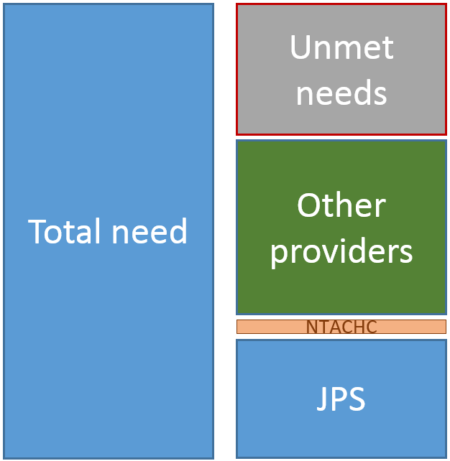
Primary Care
Overwhelming finding is need that exceeds capacity
  72 day third next available new appointment
  School-based centers have access but are limited to students and their siblings (not open to high need adults)
Low capacity for geriatric care
Recommendation
Plan for an increase in primary capacity
Further strengthen support of FQHC

Slide 9
Population health and Care Management
Population Health:
  The monitoring of health outcomes in populations
  Identification of patterns of health determinants
  Policies and interventions designed to:
    Increase healthy behaviors and influences, e.g., exercise, healthy eating, safe streets
    Reduce unhealthy behaviors and effects, e.g. smoking, medication non-adherence, drop out rates
Care Management:
  Communication/education/motivation interventions beyond the physician visit
  Resource is focused on the highest need population, particularly those with recent utilization (risk stratification)

Slide 10
Population health: Impact through Right Structures
Optimized population health impact
Delivery system
(primary care prevention, care management)
Public Health
(provide and reinforce prevention, messaging, regulation, system support)
Accountability Structure
(e.g. health plan, to organize non-medical and ensure cost control)
Optimized population health impact
Delivery system
(primary care prevention, care management, behavioral health supports)
Public Health
(provide and reinforce prevention, messaging, regulation, system support)
Accountability Structure
(e.g. health plan, to organize non-medical and ensure cost control)

Slide 11
Population Health and Care Management at JPS
JPS Connection with limited focus on population of eligible residents not-yet-seen
Health information sharing (HIE), storing (data warehouse) and analysis are limited and will become increasingly necessary to succeed with expected evolution of health care
Care management plan is in place to increase resources and to focus on care transitions
Some disease-specific care management is occurring in primary care settings
Recommendation
A robust, risk-informed care management program is needed to succeed in future population payments

Slide 12
Special Populations
Geriatric
  Source population growing dramatically
  Many programs, including a fellowship and geriatric trauma care recognition, that need to be strengthened and highlighted
Pediatric
  Increase partnership with Cook Children’s (information exchange, population health initiatives)
Active cancer patients
  Accredited Cancer Care Center recognized for quality
  Demographics and cancer-as-chronic disease (survival but need for ongoing treatment) both suggest significant investment will be wise

Slide 13
Specialty Care
Strengths
  Cancer center
  Interwoven leadership and accountability between Acclaim and JPS (true for primary care as well)
    Areas for focus
      Physical space on campus is serious impediment to efficiency
      Use of technology to de-compress specialty and improve access: e-consults, referral rules engine, schedule monitoring and reporting
      Benchmarking productivity of specialists

Slide 14
Specialty
Demand far exceeds capacity, leading to typical issues seen in specialty practices of other safety-net delivery system
Third next available for non-urgent new appointments are measured in months and for many specialty practices exceed four months
Data insufficient to know if the limited specialty resources are being used as efficiently as possible, but space certainly has negative impacts
Recommendations
Create new space as soon as possible
Create referral management system with rules and reporting
Use targeted e-consults to improve access with limited specialists

Slide 15
Emergency Department
122,000 visits budgeted for 2017, source of many admissions
Long waiting periods attributed in part to insufficient and inefficient space
Excessive holding periods waiting for inpatient beds
Ability to connect patients to a new primary care appointment is very limited
Even for current JPS primary care patients, getting a rapid post-ED visit is challenging
Recommendations
Create programs to get high-impact ED patients into primary care (and specialty as needed per referral rules)
Expand capacity with proper adjacencies

Slide 16
Inpatient
Trauma services are a major strength
Multi-bed rooms are anachronistic, posing safety and privacy issues
Two tower structure separating some diagnostics and support services causes inefficiencies and patient experience issues
Recommendation
New inpatient facilities are needed

Slide 17
Continuum of Care
The need for post-acute beds (rehabilitation and skilled nursing) is likely to increase significantly with aging population
Technology-enabled home discharge and care management will likely be expected as best practice

Slide 18
Behavioral health
Strengths
  JPS is viewed by stakeholders as the “go-to” Tarrant County provider for people with the most complex behavioral health needs
  Psychiatric Emergency Center (PEC) is a significant community asset
  Most BH performance metrics reported exceed national benchmarks including readmission rates
  JPS coordinates BH DSRIP projects

Slide 19
Behavioral health inpatient and emergency services
Trinity Springs and PEC physical spaces impose significant challenges for patients and staff
  Distance between PEC and psychiatric beds, psychiatric beds and main hospital
  Aging, physical layout, and room configuration
Limited capacity
  JPS inpatient beds represent 24% of psychiatric beds in Tarrant County (132 psychiatric beds/116 adults/16 adolescent + 15 med/psych)
  FY15 transferred 3,100 BH patients to private psych hospitals
  PEC demand exceeds physical space

Slide 20
Behavioral health expansion needs
Services for children and adolescents
Targeted services for the geriatric and aging populations
Inpatient beds and longer-term beds
Integration of behavioral health supports into community-based, ambulatory primary care and school-based settings
Urgent behavioral health care/ED diversion for behavioral health-related issues outside of Fort Worth and the main JPS campus
A substance abuse strategy and services—currently there are no substance use disorder (SUD) treatment services provided at JPS
A behavioral health population health strategy and behavioral health care management programming and infrastructure

Slide 21
Behavioral health recommendations
JPS lead the development of a Tarrant County BH System of Care
  Continue to invest in diversion (inpatient and criminal justice) programs
Continue to invest in the development of evidence-based outpatient services
  Ranging from integrated BH within primary care to specialty BH services, and substance abuse services
Build expanded PEC and inpatient BH units within or in close proximity to main hospital
  Include in PEC observation space and designated space for people experiencing substance abuse issues
  Flexible inpatient beds to serve geriatric, children 12 and younger, adolescents
  Include electroconvulsive therapy (ECT) services

Slide 22
Behavioral health inpatient bed needs
Year | Recommended Tarrant County Inpatient Psychiatric Beds *35 public beds per 100,000 (see previous population estimates) | JPS Recommendations (based on 50% County need) | Bed Gap Based on Current Number of JPS Psychiatric Beds at time of publication: 132 beds
2017 | 707 beds | 354 beds | 222
2022 | 784 beds | 392 beds | 260
2027 | 861 beds | 431 beds | 299
2032 | 945 beds | 473 beds | 341
2037 | 1032 beds | 516 beds | 384
Assumptions
Continued investment in outpatient and diversion services
Continued lack of capacity and state psychiatric facilities
JPS will continue to contract with private psychiatric facilities

Slide 23
Medical Education
Strengths
  Fully accredited programs in family medicine, psychiatry, emergency medicine, obstetrics/gynecology and orthopedics
  Family medicine program is nationally recognized and highly competitive
  Good reputation and strongly desired site for clinical experience
    Areas for focus
      A plan for responding to need for Graduate Medical Education (GME) in county for internal medicine subspecialty and surgical specialties
      Recruiting JPS graduates to become attending staff
      Developing a full partnership with medical school
      Physical space and facilities to be attractive for teaching and recruiting

Slide 24
Medical Education
GME for many specialties are missing in county and will be needed
Education is not only a core part of mission but also excellent mechanism for building staff pipeline (physicians, nurse practitioners in future, other non-physician staff)
Recommendations
Tighter affiliation with UNTHSC/TCU, with institutional goals defined
Recruitment of trainees, including with intent to better match workforce to patient population
Increase support for training and education in behavioral health
Incorporate population health into curricula

Slide 25
The delivery system
Question and Answer
Discussion

