Slide 1
CITIZENS BLUE RIBBON COMMITTEE
FINDINGS REPORT | June 6, 2017
Notes:
Sandy

Slide 2
SCOPE OF STUDY
On-Campus In-Patient Services Focused
Review Existing Project Documentation
2010 BOKA Powell Report
2014 Blue Cottage & Broaddus Report
2014 Proposed Construction Project
Update 2014 Estimate to 2017
Evaluate Existing Campus Conditions
Evaluate Options within Proposed Projects for Renovation
2
Notes:
Bill

Slide 3
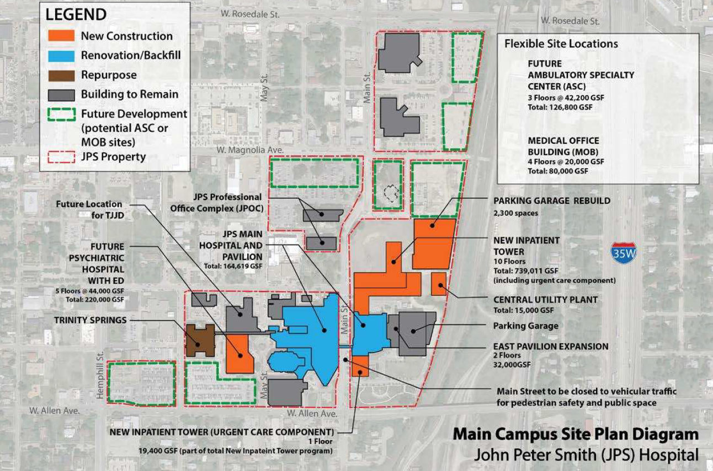
MAIN CAMPUS SITE PLAN
3
Notes:
Bill

Slide 4
NEW INPATIENT BEDS
Additional Capacity Needs Identified To Keep up with Tarrant County Growth
Current Bed Count – 409 (60% Semi-Private)
2014 Study - 496 Beds at completion plus 120 shell (616 Total)
HMA/Cumming Study - Recommends 20 Year Bed Need at 664
Improved Efficiency of Other Departments (ED, Surgery, etc.)
Properly Sized Rooms (caregiver, family, patient, education, technology)
Develop All Private Room Model
Better Patient Outcomes
Follows Industry and Best Practice Standards
Improved Patient Satisfaction (Maximize Reimbursement)
Improved Infection Control
4
Notes:
Bill

Slide 5
EXISTING TOWER LIMITATIONS
Existing Tower Limiting for Renovated Acute Care - 1960’s Vintage
Low Floor to Floor 11’ vs Current Standard 14-15’
Small Footprint leads to inefficient bed units (14-17 vs. 30 beds)
Limited Space Requires Added Space to Satisfy Program (approx. 112 of 360, plus 120 shell future beds)
Existing MEP Systems are Significantly Beyond Useful Life, Complete Replacement
Renovation Cost Approx $375/sf vs. New Construction $410/sf
Higher Space Per Bed for Renovation vs. New Construction
Split In-Patient Unit’s Maintain Significant Operational Inefficiencies
Cumming Team Does Not Recommend Existing Tower for any Inpatient Acute Care Services
5
Notes:
Bill

Slide 6
INPATIENT BED TOWER
2014 Cost Estimate - $609M – Escalated to 2017 - $739M
Total JPS Beds – 496 Plus 120 Shell Beds
* Includes Tower, Site Work, Central Plant and Parking Garage
Cumming Estimate of Original Plan - $706M
Construction – 2020 - 2023
6
Notes:
Bill

Slide 7
INPATIENT BED TOWER UPDATES
Cumming Recommended Updates - $40M
Larger Program due to updated regulations and larger patient rooms 340 vs 290 - $35M
Larger Parking Garage 380 sf/parking stall vs. 350 - $5M
HMA Recommends Complete Shell Beds - $64M
120 Total Beds (2 floors of 60 beds each)
Total JPS Beds – 616
HMA/Cumming Recommended Bed Total $44M
Recommends 664 beds at 20 years
Add one bed floor – 60 Beds
Total Bed Count – 676 Beds
7

Slide 8
NEW TOWER COST SAVINGS OPTIONS
Maintain Existing Materials Management and Laundry Services
Cost Savings - $24M
Lower Staffing Efficiency due to remote location
Existing Capacity Issues Remain Unresolved
Renovate Food Service Department in Existing Location
Cost Savings - $5M – Not Recommended
Limited size due to existing constraints
Lower Staffing Efficiency due to remote location
Existing Location is Sub-Optimal
Optimize Existing Energy Plants to Eliminate New Plant
Cost Savings - $33M - Recommended
NEXT STEPS
Confirm Bed Needs Analysis
Confirm Ancillary Needs Analysis (OR’s, Imaging, ED spaces, etc.)
Review Possible Consolidation of ALL Inpatient Needs to new Tower
8
Notes:
Bill

Slide 9
RENOVATION/BACKFILL
2014 Cost Estimate - $94M – Escalated to 2017 - $114M
Cumming Estimate of Original Plan - $95M
Construction - 2023
Leaves approximately 280,000 square feet vacant
Trinity Springs Building – 64,000 sf
Laundry/Materials Mgt. Building – 36,000 sf
Hospital Tower and Attached Buildings – 180,000 sf
Potential Outpatient Services, Offices, Psych Services, Other Ancillary Uses
NEXT STEPS
Evaluate JPS Network for Additional Uses for Renovated Space
Evaluate Proposed Specialty MOB and ASC to Accommodate Existing Services
9
Notes:
Bill

Slide 10
NEW PSYCH TOWER
10
Notes:
Bill

Slide 11
PSYCH HOSPITAL
Current Psych Bed Total – 96 Beds
2014 Study 148 Beds, Plus 50 Shell (198 Total)
HMA Study 516 Beds (at 50% of population need)
Existing layout issues:
Limited Bed Count
Over reliance on semi-private beds reduces capacity
Intake/ED is poorly located (10th floor)
Three separate locations creates patient transfer issues
11
Notes:
Bill

Slide 12
NEW PSYCH TOWER
2014 Cost Estimate - $102M – Escalated to 2017 - $124M
Cumming Estimate of Original Plan - $125M
HMA Recommendations Completing Shell Beds - $19M
198 Total Beds at Completion
Construction - 2021-2023
NEXT STEPS
Confirm and Update Bed Needs Analysis
12
Notes:
Bill

Slide 13
DEMOLITION OPTIONS
Cost to Demolish Trinity Springs Building 66,000 sf - $3M
Potential Re-Use to Consolidate IT Services/Other Support
Cost to Demolish Materials/Laundry Building 36,000 sf - $2M
Cost to Demolish Balance of Existing Buildings 180,00 sf - $41M
Includes $28M Renovation Allowance for Consolidation of Remaining Occupants
13

Slide 14
Q & A
14

